Slide 1

G2M insight for Cab Investment firm
Company Name : XYZ Location: Denmark Date: 27-06-22
By: Hiten Chadha

Slide 2

Agenda
Problem Statement
Approach
EDA
Hypothesis Testing
Building Models
Recommendations

Slide 3
Description:
XYZ is a private firm in US. Due to remarkable growth in the Cab Industry in last few years and multiple key players in the market, it is planning for an investment in Cab industry and as per their Go-to-Market(G2M) strategy they want to understand the market before taking final decision.
Provide actionable insights to help XYZ firm in identifying the right company for making investment.
Cab Companies:
- Yellow Cab
- Pink Cab
The Analysis include :
- Data Understanding,
- Data Visualization,
- Creating multiple hypothesis,
- Building models and finding the best fit model based on Accuracy

Slide 4
Data Preparation:
Cab_Data.csv – this file includes details of transaction for 2 cab companies.
Customer_ID.csv – this is a mapping table that contains a unique identifier which links the customer’s demographic details.
Transaction_ID.csv – this is a mapping table that contains transaction to customer mapping and payment mode.
City.csv – this file contains list of US cities, their population and number of cab users.

Slide 5
EDA

Slide 6
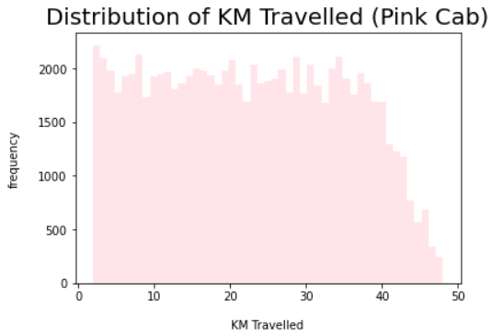
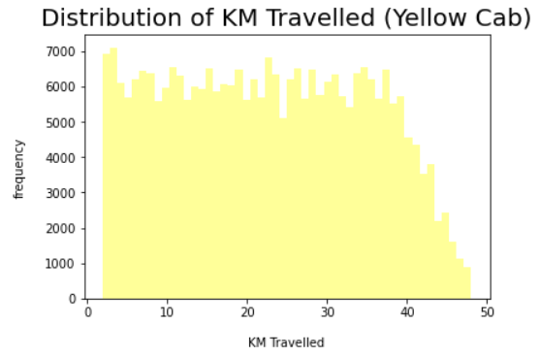
Distribution of KM Travelled for both Cabs:
From the above graphs, we can see that for both Pink and Yellow Cab most of the rides are in the range of approximately 2 to 48 KM.

Slide 7
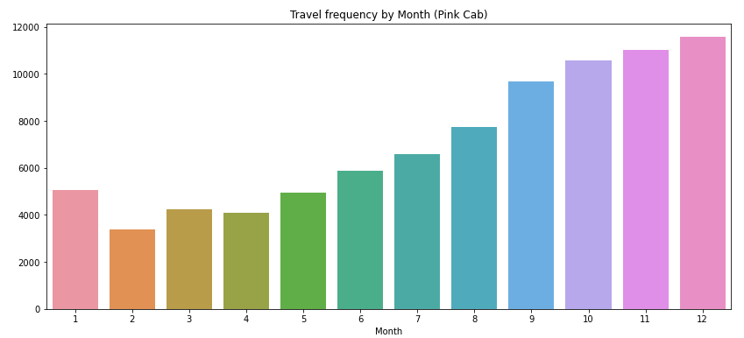
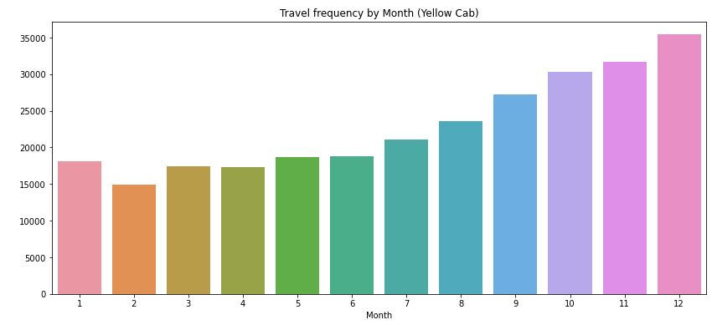
Travel Frequency per Month:
Yellow Cab has higher travels (35000) in the month of December which is the holiday season compared to Pink Cab (11000).

Slide 8
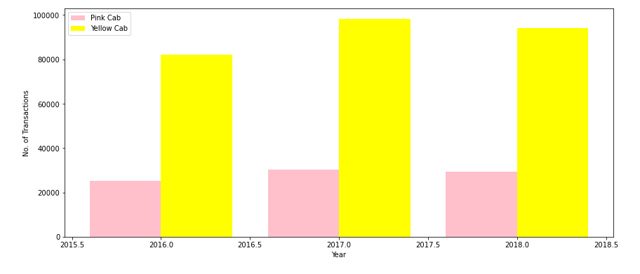
Transaction per Year for both Cabs:
From the graph it shows that on yearly basis no. of transactions for Yellow cab is higher than Pink cab.

Slide 9
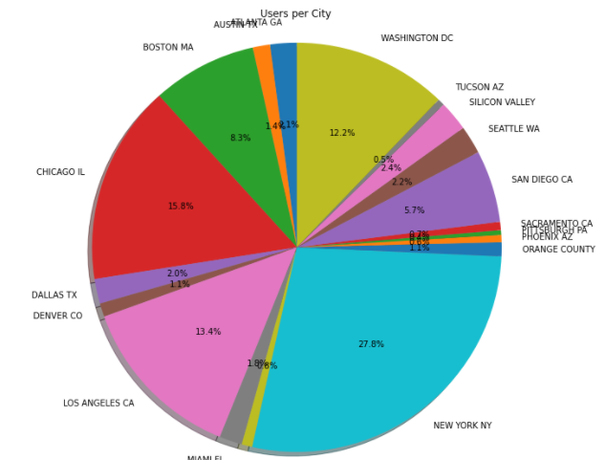
Cab Users per City:
New York City has the highest Cab users with 28% followed by Chicago with 16% and Los Angeles with 13%

Slide 10
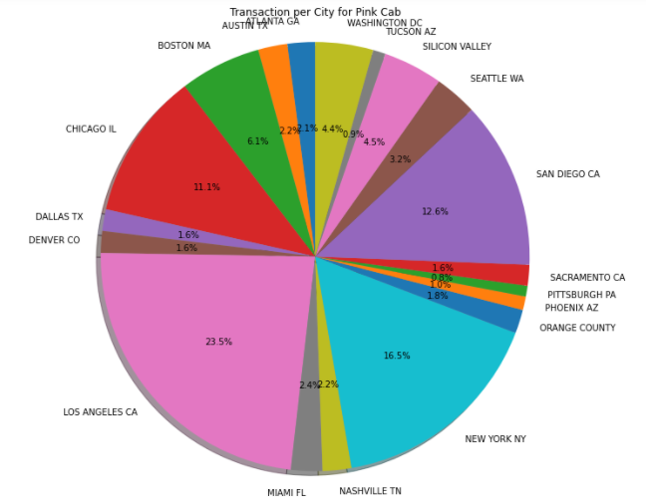
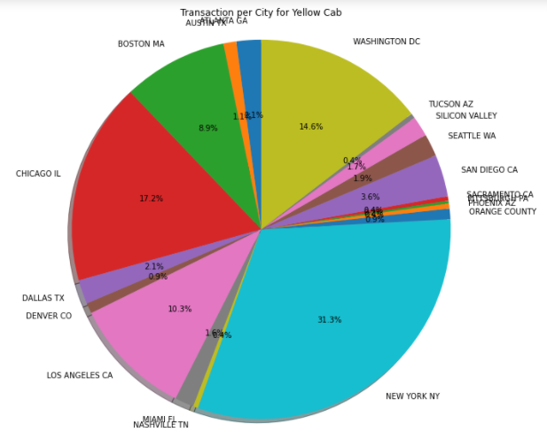
Transaction per City for both Cabs:
Transaction for Yellow Cab is highest in New York City(31%) and New York City has the highest Cab Users of 28% as per the previous slide.
Transaction for Pink Cab is highest in Los Angeles City.

Slide 11
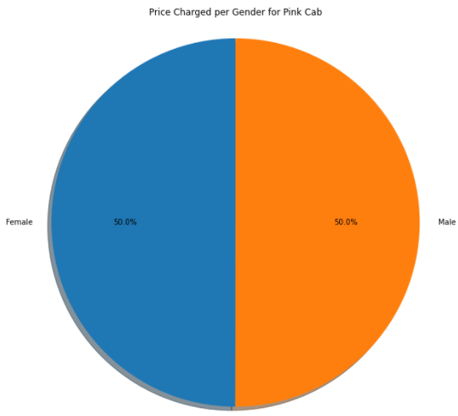
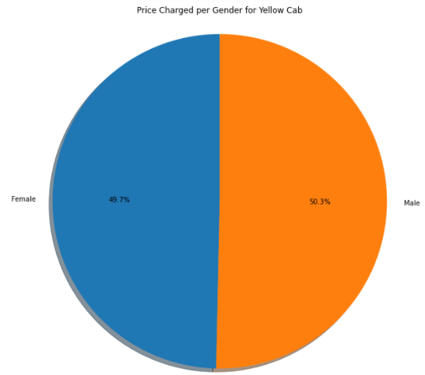
Price Charged per Gender for both Cabs:
Yellow Cab charge less from Female Customers whereas Pink Cab charges same for both Male and Female Customers.

Slide 12
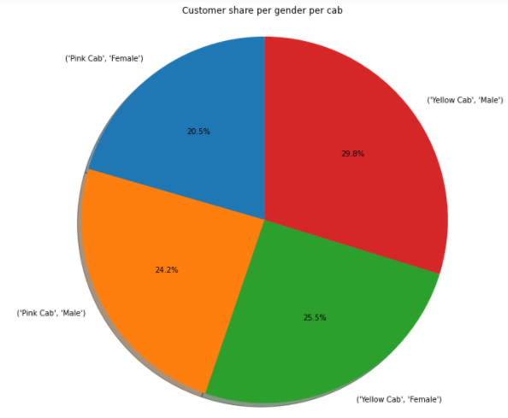
Customer Share per Gender for both Cabs:
Female Customers in Yellow Cab(25.5%) is higher compared to Pink Cab (20.5%)

Slide 13
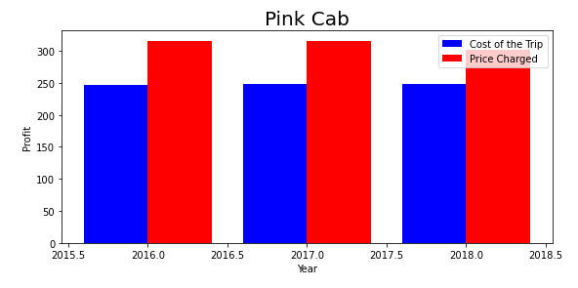
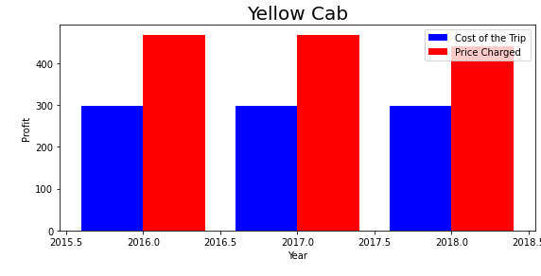
Profit Margin per year for both Cabs:
From the Graphs, it shows that the Yellow cab has a higher Profit Margin (Price Charged - Cost of Trip) compared to Pink cab.

Slide 14
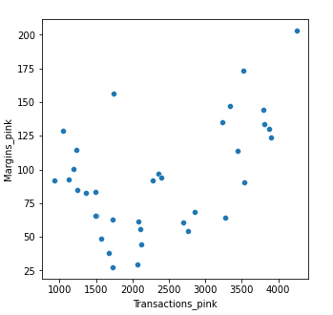
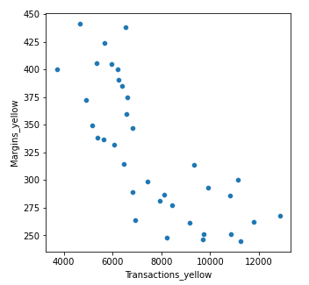
Margins per Transactions:
Margins: Price Charged – Cost of Trip
Pink Cabs increase margins with increase in number of Transactions.
Yellow Cab decrease Margins with the increase in Transaction.

Slide 15
Hypothesis Testing

Slide 16

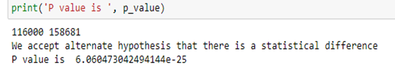



Slide 17

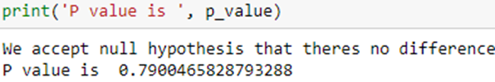



Slide 18
Recommendation
Transaction per year: For Yellow Cab Transaction per year from 2016 to 2018 is almost double than Pink Cab.
Margin per Gender: For Yellow Cab there is difference in Margin between Male and Female Customers due to which Female Customer percentage is higher in Yellow Cab in comparison to Pink Cab.
Profit Margin: For Yellow Cab the Profit Margin is higher per year from 2016 to 2018 in comparison to Pink Cab.
Margin per Age: In Yellow Cab there is difference in Margin for people older than 50 yrs, whereas in Pink Cab there is no difference in Margin of all age group.
Yellow Cab decreases Margins with the increase in Transaction, hence for Yellow Cab the travel frequency during the Month of December which is the holiday season is 3 times more than Pink Cab.
Customers for Yellow Cab is highest in New York City which has the highest Cab Users of 28%.
On the basis of the above points, Yellow Cab is recommended for investment.

Slide 19
Thank You

